Slide 1
Financial Stability & Integrity Track:
Innovations in Technology for Financial Inclusion & Managing Risks

Slide 2
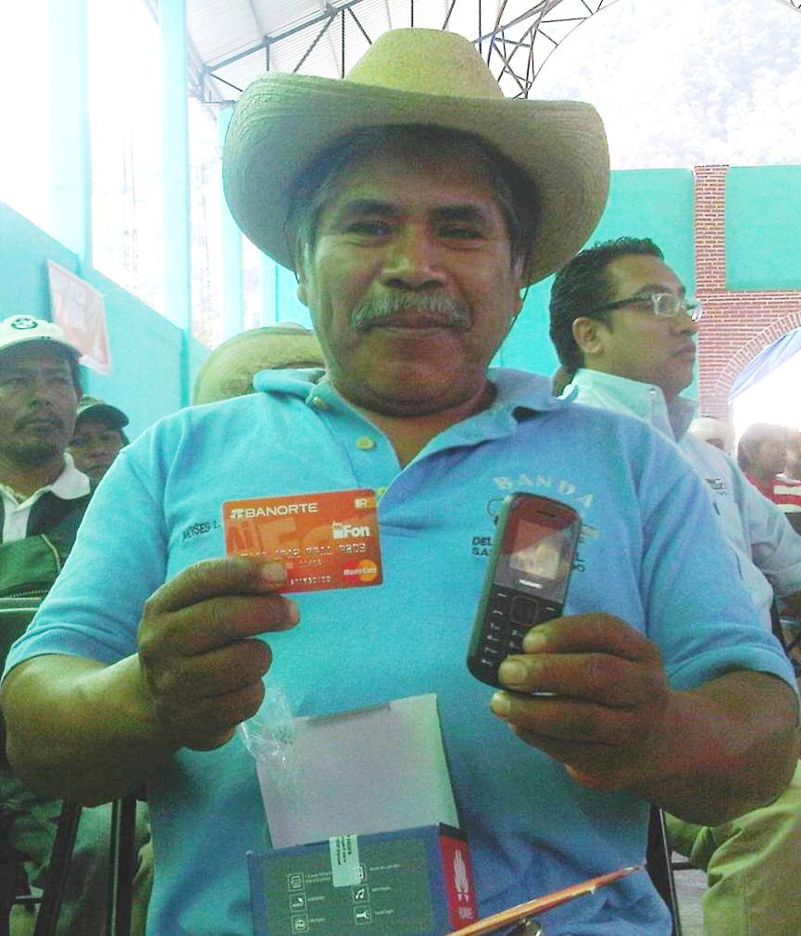
Role of Technology and Innovation in Promoting Financial Inclusion
AFI Global Policy Forum
September 11, 2013
Omokehinde Ojomuyide MasterCard Worldwide

Slide 3
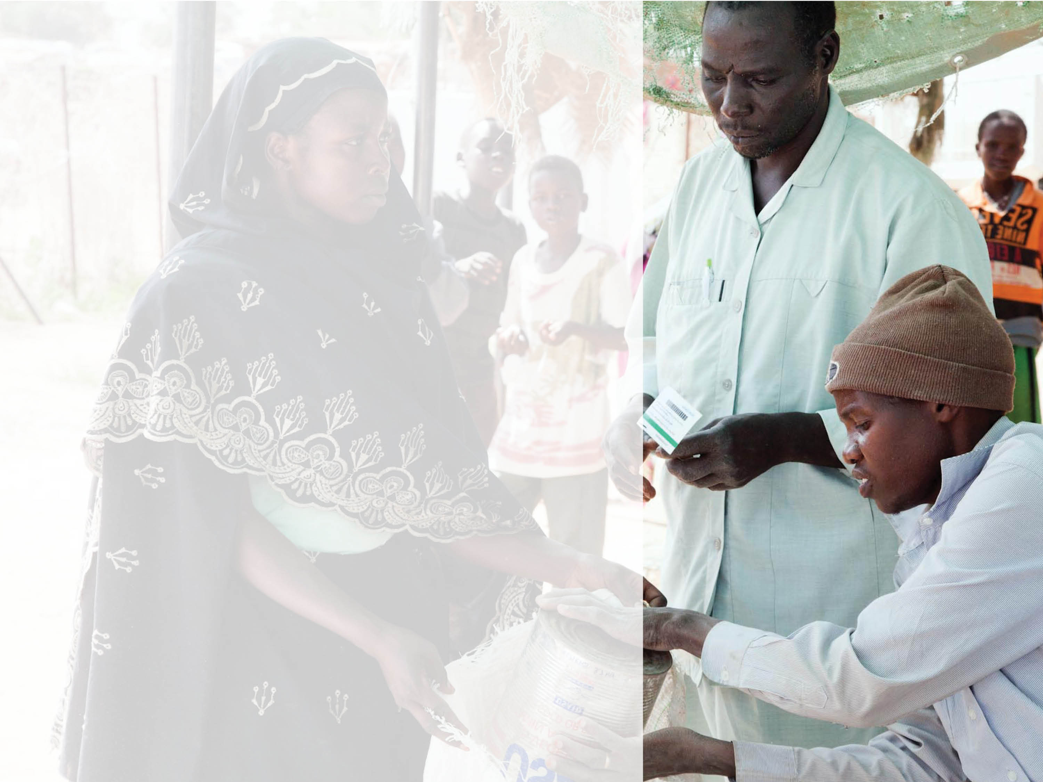
Electronic payments drive
ECONOMIC EMPOWERMENT
2.5B
DON’T HAVE ACCESS TO FORMAL FINANCIAL SERVICES
… and 85% of all retail transactions are still in cash and checks
Notes:
We see a world that is very connected for some, but not for all; we see technology doing many good things, but we also see 85% of retails transactions still in cash; and, we see 2.5 billion adults with no access to formal financial services – a situation often linked to poverty.
Those who live in cash- or check-dependent societies are vulnerable to theft, expensive check cashers, and payday lenders. Merchants in developing countries must contend with fraud, bounced checks and unpaid loans.
We believe that everyone has the right to safe, affordable ways to save, invest or transfer funds and electronic payments can be a driver of financial inclusion and economic empowerment.
Stress the points
Technology alone cannot solve financial inclusion challenges. Financial education and adequate risk management are needed to make new solutions attractive these segments

Slide 4
Barriers to Widespread Financial Access
Low Levels of Financial Access
Financial Education
Identification of people
Business model for financial inclusion
Notes:
What are the major barriers inhibiting widespread access to financial services?
Long-standing barriers continue to pose challenges to achieving financial inclusion, and there are three in particular that need to be recognized and addressed if we are to make significant progress:
Business Model for Financial Inclusion: We need to acknowledge that reaching the unbanked/underbanked is expensive. The traditional bank branch model costs too much – putting them up and running them, and extending reach into new geographies – and the branchless model has not been fully developed and is not yet economically sound.
Further, banks operating in the traditional sense (making money off of float & fees) do not make money off the base of pyramid, so the rationale for investment is stressed. We need to recognize that there is no economic value to make these investments, especially when they have to manage risk and comply with necessary regulations.
Identification of People: We need to know who the people are. Know Your Customer (KYC) and other regulations are in place for the right reasons. But it is not easy to do with the underserved population unless government creates an ID scheme. So there is a great need for public private partnership that enables formal financial services.
Education: The traditional approach has focused on budgeting and saving – but what is needed is education to help people understand that being included in financial services is in their best interests and at the same time build trust in the system and increase usage of financial products.
There also needs to be a strong focus on creating a consistent stream of money in as an effort to drive electronification. This is where the maximum leakage takes place and opportunities to create efficiency come into play. The mistake many make is trying to boil the ocean and create money in and out solutions at the start. Money out needs a large ecosystem, and can happen once the cash in challenge is addressed.

Slide 5
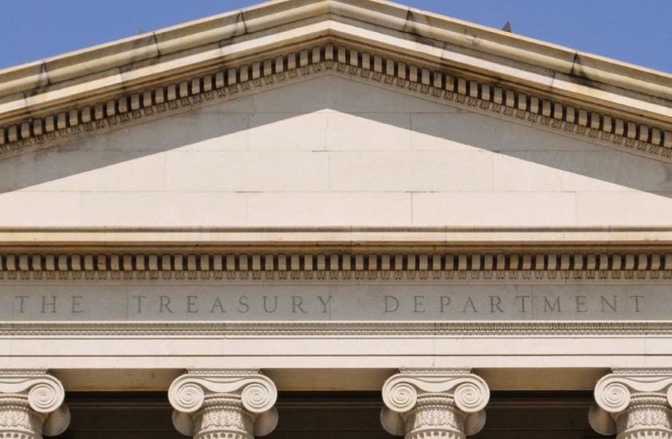


MasterCard Approach
PUBLIC PRIVATE
PARTNERSHIPS
PROCESSING
PRODUCTS /
FORM FACTORS
MERCHANT
ACCEPTANCE
& APPLICATIONS
USAGE &
EDUCATION
RISK MANAGEMENT
Notes:
What lessons learned can be distilled from encouraging examples of success that you have seen in overcoming some of these barriers?
First there is the immense value of public private partnerships – and the importance of government actively wanting to create the right environment and working with the private sector to accomplish their goals. This ranges from identity, building the ecosystem, collaborating on education and creating money-in platforms.
Second is that there needs to be a market organizing approach that brings all the players together. This includes working with both bank and non bank partners to process transactions, drive acceptance, develop relevant financial education materials, implement appropriate risk management and fraud mitigation tools.
Finally, don’t’ be in a hurry to deliver the final outcome of full financial inclusion and participation. Figure out how to do it right by bringing appropriate money in/out solutions and employing the 5-Step ATM to POS model.
Starts with easy cash out of funds. Then builds over time to include use in emergencies, then bigger ticket purchases, and ultimately use for small ticket items on a regular basis.
Drive financial inclusion for consumers around the world by delivering innovative products and services through various form factors
Provide products to people around the globe with increased transparency and better security to help improve their daily lives

Slide 6
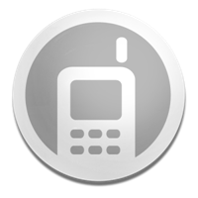

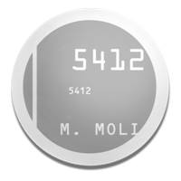
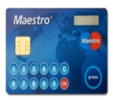


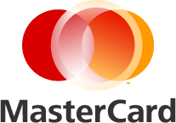

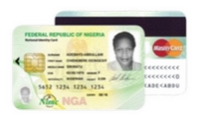

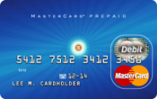
Role of Innovation and Technology in Promoting Financial Inclusion
MasterCard is leveraging new innovations to overcome barriers to financial inclusion
Chip/NFC
Mobile
P2P
Cash
Reloads
MasterCard
Bill Pay
Biometrics/ID
Acceptance
Prepaid
Financial Education
Notes:
Leveraging Innovation in Financial Services technology & ID Systems Enables High Quality, Low Cost Access.
key areas include:
ID facilitates full KYC and enables broad financial servicing
Savings and payment products
Credit bureau that better enables responsible credit access
Prepaid, debit cards and mobile money accounts serve as virtual accounts
Online payment for services, utility bills, insurance, taxes
Secure cash deposit and withdrawal
Secure transactions at Point Of Sale (POS)
Provide efficient remittances
Biometrics provide efficient delivery of government
Low cost and secure electronic delivery
Leakage reduction - Eliminate duplicate beneficiaries and provides “proof of life”
All these innovations enable Scalable Efficiency & Financial Inclusion

Slide 7



Creating shared value through
PARTNERSHIPS
that are good for business
and good for society
Notes:
MasterCard is bringing assets, expertise, and technology to create a seamless end-to-end approach though our engagement with government and NGO partners to overcome barriers
For example, MasterCard is partnering with governments around the world to transition social and procurement programs from cash and check to electronic payments. And in the process, reduce leakage/corruption, costs of implementation and increase efficiency and transparency.
Lets explore examples of where MasterCard has applied this innovations

Slide 8


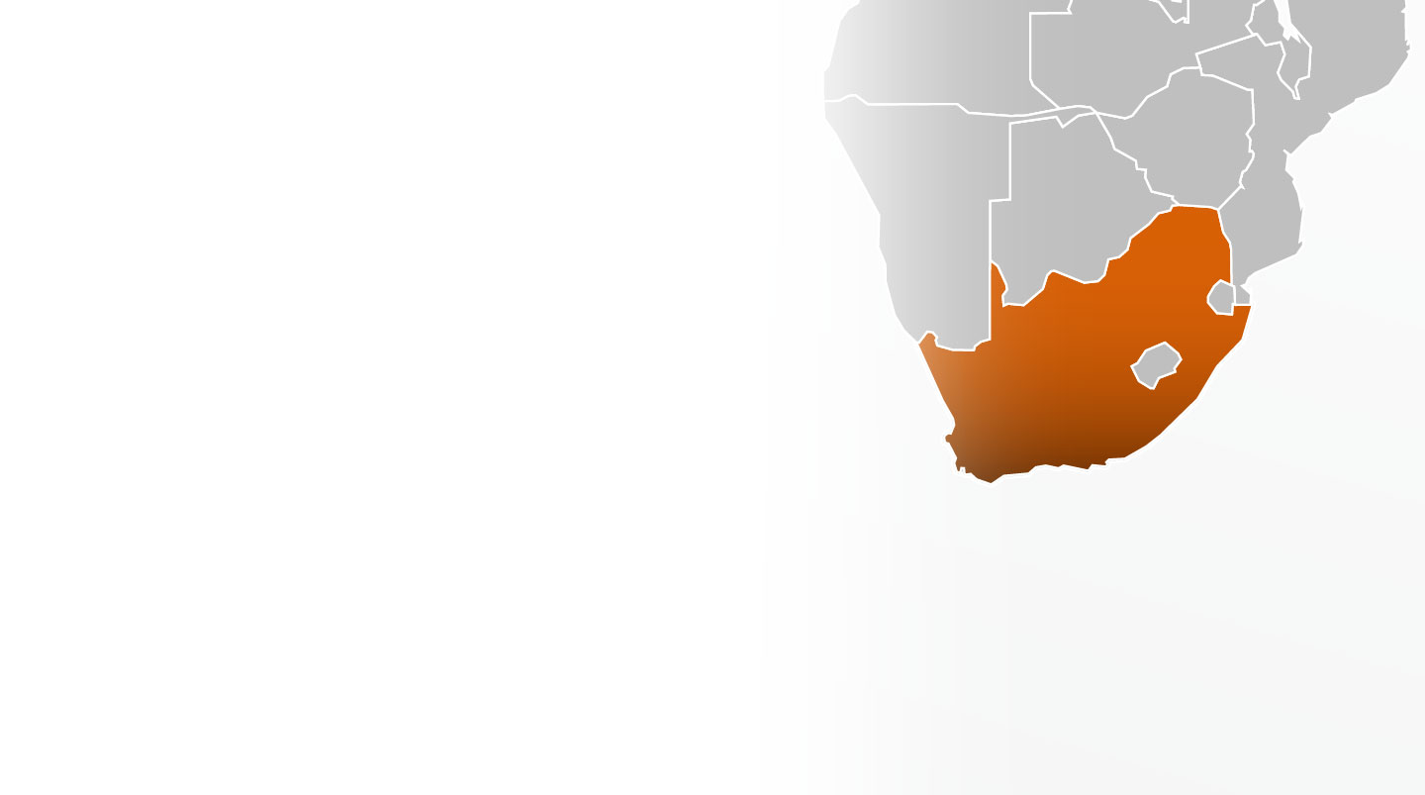
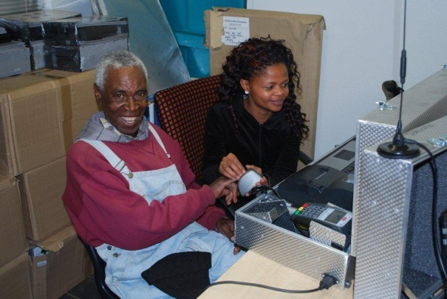
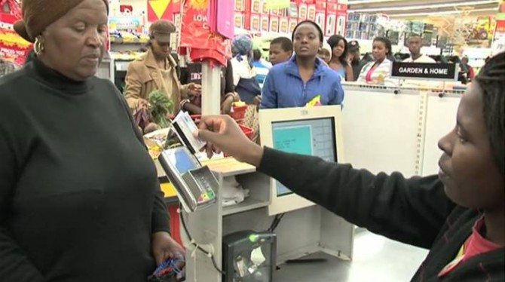
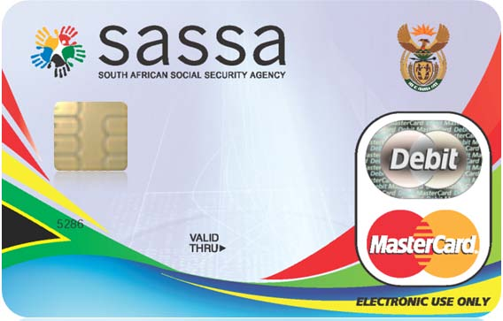
South Africa: SASSA Program
Financial Inclusion through a technologically advanced program
10M cards issued delivering benefits to over 20M people
Local enrollment with instant issuance
Fraud preventing biometric technology
POS – Cash access and purchase
On-line & Offline Functionality
$375M operational savings
Notes:
SASSA manages the disbursement of 15 million grants per month, and majority of grant recipients do not have access to banking products.
Introduction of the SASSA Debit MasterCard card – including EMV/UEPS and biometric functionality
Card is currently being issued by Net1 and Grindrod Bank in association with SASSA
Multi-purpose card = cardholders are able to use the debit card for paying for goods, checking account balance, withdrawing cash at ATM’s and POS
New system is dramatically reducing SASSA’s operating costs
Total operating saving over the next 5 years is $375 million. Previously SASSA paid between $3.25 and $4.38 per grant distributed (through legacy forms), the fee has now been capped at $2.07 per grant distributed
Budget saving will be allocated more effectively, helping to impact more South African lives
Develop educational pamphlet with basic information on card features and benefits – distributed at the time of enrollment
Driving behavior from cash to POS by allowing cash-back at POS
Further activities planned to drive usage at POS in 2013 including targeted educational materials

Slide 9


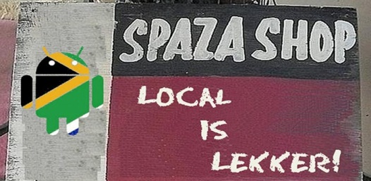
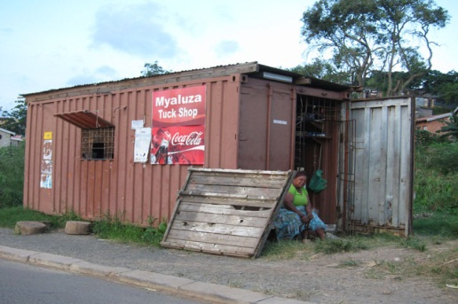
South Africa: Small Business Acceptance
Market organizing through innovative acceptance partnership
Need to expand payments ecosystem
Pre-negotiated acceptance at large chains
Gap in acceptance at “Spaza” township stores
New partnership with Blue Label
  Established Relationship with BOP Merchants
  Largest distributor of pre-paid e-tokens
  Card acceptance at Spaza merchants

Slide 10

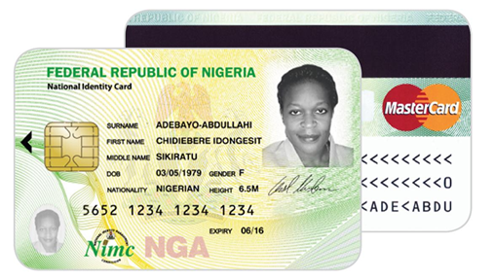
Nigeria: ID Card Program
Using ID as a means to deliver broad financial services
A reloadable Prepaid EMV Debit MasterCard
  Chip & PIN security
  Card is personalized with ID photo and biometric data
Card Activation & PIN Selection/Delivery
  At the time of collection through POS in NIN Enrollment Centers, also at ATMs or by Call Center
Proposed Load/Reload channel(s)
  POS at NIN Enrollment centers, Bank branches, at selected merchant locations
  ATMs which accept cash deposits
  By enabling Card to Card transfer on Cardholder web portal
  Bank Web Portal for existing bank customers
  Mobile Wallet (Phase 2)
Supported Transactions
  ATM Cash withdrawals & POS Purchase transactions
  Bills Payment, P2P Transfers, POS Cash Advance
  eCommerce & mCommerce
Notes:
National Identity Management System (NIMS)
Enrolment of citizens and legal residents;
Issue a National Identity Smart Card to every registered person 16 years and above
Provide a secure means to access the National Identity Database so that an individual can irrefutably assert his/her identity
Integrate Identity Databases in Government Agencies
Register births and deaths via collaboration with the National Population Commission.
Public-Private Partnership approach
NIMC to provide backend infrastructure
Private partners / Front End Partners (FEP) to fund and manage front end components
NIMC has taken the role of the FEP for the initial pilot phase and has selected MasterCard as their preferred payment brand

Slide 11




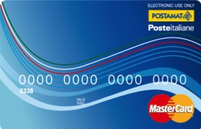
Italy: Poste Italiane
Leveraging Postal Network for Financial Inclusion
Poste Italiane uses Prepaid cards to disburse benefits
Situation
Italian government sought to drive efficiency in social welfare disbursements and obtain more data about welfare expenditure
Solution
Reduces distribution/reload costs
Prevents misuse of funds by restricting acceptance criteria
Dual network solution (open/closed loop)
Real time eligibility screening
MCC filter on authorized merchants only
Strategic merchant / utility partnerships providing discounts and special services
Notes:
Holders of the Purchase Card is recognized by the contracted stores and pharmacies that support the program, a discount of 5 percent. The discount is granted only for purchases made exclusively through the Purchase Card and is not applicable to the purchase of medicines or for payment of prescription charges.
The stores participating in the initiative expose the following sticker:
The discount is combinable with other promotions or discounts to encourage customers in general, as well as with those of the same kind guaranteed to holders of loyalty cards issued by the stores themselves (eg, from supermarkets).
A second store, the discount can be recognized by immediate deduction from the spending account, or recognizing a "good" used to make purchases.
Rules for correctly using the Purchase Card :
The Charter should be used only by the owner . Sign it in the space on the back and does not transfer it to others;
Each card has a personal code , the PIN , you will be sent home.
sure it stays secret, do not write it on paper and keep it with your documents or to the Charter itself;
You can use the Card only in grocery stores, pharmacies and drugstores enabled the MasterCard and post offices to pay electricity bills and gas supply;
The use of the Card is free , does not get any commission;
Charter shall state the period of validity , but if after his release, your requirements are not consistent with those required, the Ministry of Economy and Finance may suspend or terminate the Purchase Card;
You can not withdraw cash or reload the map. Its use is permitted only in ATM Postamat to control the balance and the list of movements ;
If you use the card POS terminals and ATMs in post offices or Postamat, you must enter your PIN code , which is the only means of identification. In grocery stores enabled the MasterCard, however, you must sign the receipt of the POS and, if requested, showing proof of identity

Slide 12


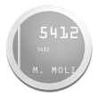


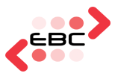



Egypt: Mobile Payment Solution
World’s First Interoperable Mobile Money Between Operators
In Partnership with the Egyptian Central Bank, MasterCard is providing a national mobile payment switch
Telcos and Banks connected through the MasterCard Mobile Payment gateway are providing an array of financial services to the unbanked
17,425 Cash In / Out Points
A mobile phone-based initiative allowing consumers to make payments, conduct person-to-person remittances and pay their bills
Significant reduction of cash in-flows
August 20, 2013
Page 2
Notes:
MasterCard has partnered with the Egypt Central Bank and its technology arm EBC to provide a national mobile payment switch for all mobile based transactions. The current ecosystem includes the countries largest bill payment aggregator, Fawry, the National Bank of Egypt (NBE) and the mobile operator Etisalat.
Etistalat consumers can transact with customers who have the NBE-based application and soon the other mobile operators will join the ecosystem.
Working with Fawry, an Electronic Bill Payment and Presentment network in Egypt, allowing consumers to pay bills using their MasterCard at retail locations, online or via ATMs
There are now 17,425 cash in and out points, which is more than the 4,600 ATMs or 3,600 bank branches

Slide 13
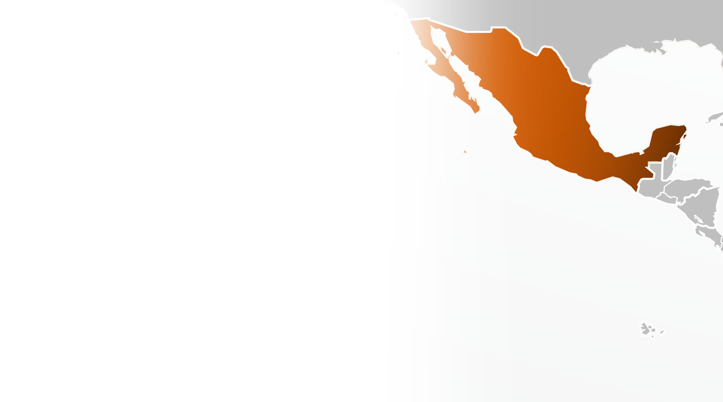
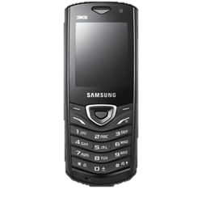
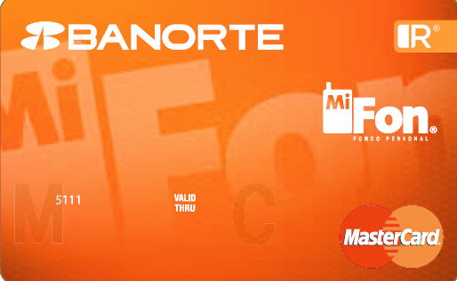
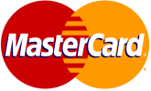
Mexico: Mobile and Prepaid Program
Financial inclusion solution for rural Mexicans
Support financial inclusion by giving rural Mexicans an electronic payments solution
A successful private-public partnership connecting consumers in a remote village to an electronic and mobile payments ecosystem
A mobile phone-based initiative allowing consumers to make payments, conduct person-to-person transfers and make local calls
Significant reduction of cash in-flows
Notes:
Santiago Nuyoo Pilot
During Q4 2011, Telecomm-Telegrafos, decided to adopt Mi Fon program to test its concepts about the role of mobile payments and the creation of electronic payments ecosystems for rural communities
In January 2012, Telecomm launched a pilot in an isolated mountain community named Santiago Nuyoo, in the state of Oaxaca. The community lacks the presence of financial institutions of any kind, and even, mobile communications.
The pilot consists in the deployment of a mobile ecosystem to facilitate financial transactions into the community; otherwise those financial transactions have to be done in other community far away
During the first months of the pilot some findings are rising:
• Mobile account penetration is possible in rural areas (50% of adults opened a mobile account).
• Reduction of cash inflows (36% reduction on Telecomm cash needs).
• Relevance of merchants to drive adoption and usage (a 75% increase in the P2P average amount)

Slide 14
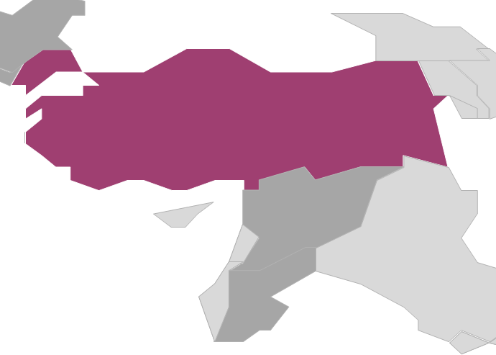

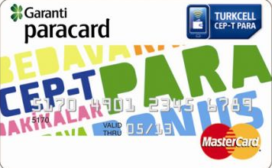
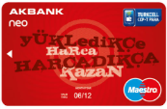
Turkey: Mobile Payments and NFC
A Well Developed Payments Ecosystem
Provides an array of financial transactions to both the banked and unbanked subscribers
Cash in points at all Turkcell agents
Using the mobile, subscribers can make purchases, transfer money, pay bills, purchase mobile airtime, get cash from ATMs, and keep track of their balances and activities
Subscribers who have Near Field Communication (NFC) enabled phones can perform tap and go transactions
350,000 pre-paid cards were sold in the first six months since the launch of Mobile Money Services in June 2011
Notes:
Garanti Bank recognized it could extend its reach with a Mobile Money Services proposition. However, Garanti required access to a mobile network infrastructure and partnered with Turkcell, the country’s leading GSM operator. With MasterCard Mobile Payment Gateway, we delivered an end-to-end mobile payment capability.
This Garanti example illustrates that the Mobile Money Services model is already demonstrating its potential to revolutionize the way consumers distribute funds, regardless of their income or credit status, and promote financial inclusion.
The services works with all Turkcell phones (Smart phones to feature phones). Consumers with an NFC-enabled phone can do Tap and Go transaction in addition to the remote transactions previously mention. The NFC is still MC exclusive. Besides, 6 banks have completed their integration and offering their NFC services to their customers currently. We have also working with Turkcell to provide NFC awareness and increase consumer demand.

Slide 15

Innovation and technology can
DELIVER ON
THE PROMISE
of greater financial empowerment for everyone

